Slide 1
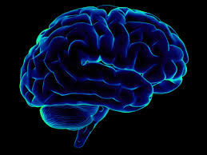

Diabetes Readmission Prediction
Communication is the key
By:
Akanksha Utreja(11910056)

Slide 2
Executive Summary (Abstract)
Hospital readmission rates for certain conditions like diabetes are now considered an indicator of hospital quality, and also affect the cost of care adversely.
So, we use the medical dataset available on UCI to find best models which can help predict the readmission of diabetic patients.
Used Python and it’s libraries like scikit-learn for machine learning, seaborn and matplotlib for visualization etc.
Using different models like Logistic Regression, Decision trees, Random forest and AdaBoost Classifier.
Out of the different models used, Random forest had good performance.

Slide 3
Business Problem
The stakeholder of this project will be the hospital officials who can use the results to figure out which patients have higher readmission chances.
This will help save hospital millions of dollars and also, improve the healthcare quality.
With this project, the aim is to find the best model for readmission prediction and the factors which most likely affect the readmission.

Slide 4
Business Problem
Process used:-
Data Wrangling(Missing values, Data cleaning, standardization etc.)
Data Collection
EDA & Visualizations
Modelling:
Logistic
Decision Trees
Random Forest
AdaBoost Classification

Slide 5
Data Requirements & Collections
The data source used was the UCI website, it represents 10 years (1999-2008) of clinical care at 130 US hospitals and integrated delivery networks.
It includes over 50 features representing patient and hospital outcomes. There are around 1,00,000 records.
The data was available in the form of Excel sheet.
It was read in the Python file and the analysis was performed on that data.

Slide 6
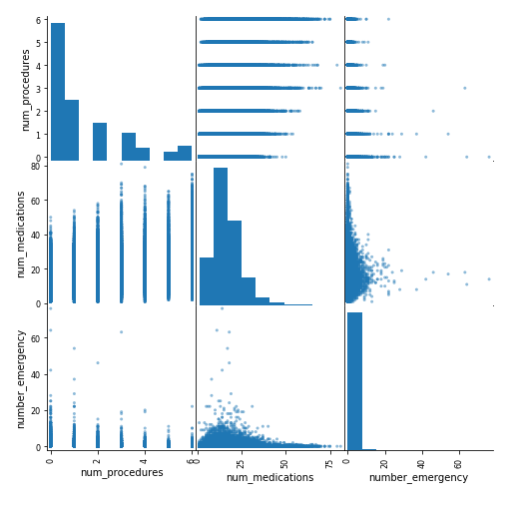
Data Understanding
Performing Exploratory data analysis to get a basic sense about the data.
Since there are multiple variables,
trying to figure out the correlation
so that we can use less variables.

Slide 7
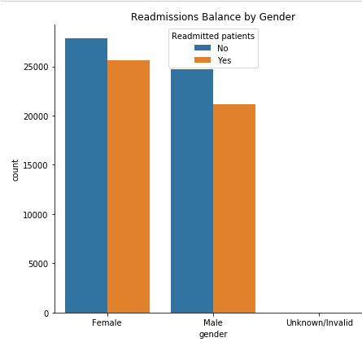
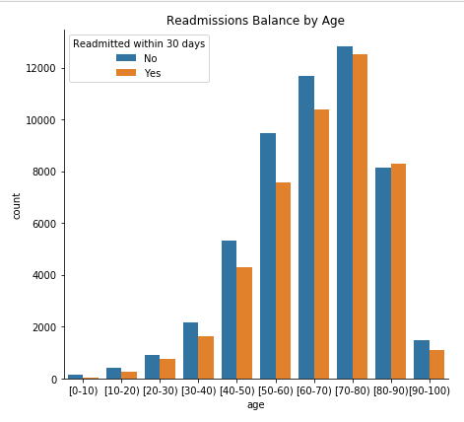
Data Understanding
Figuring out the effect of different variables on readmission,

Slide 8
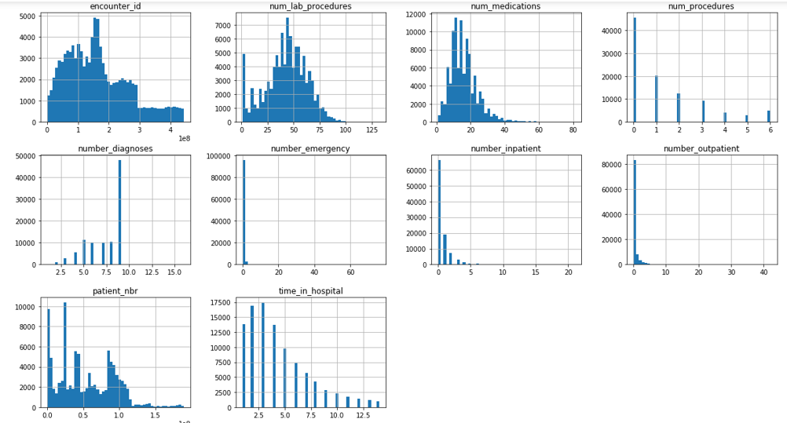
Data Understanding
Viewing the numerical and categorical variables in the dataset to understand the dataset better,

Slide 9
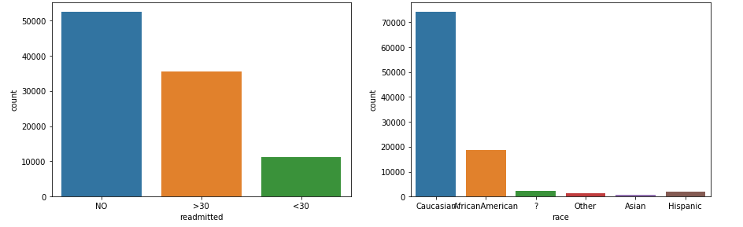
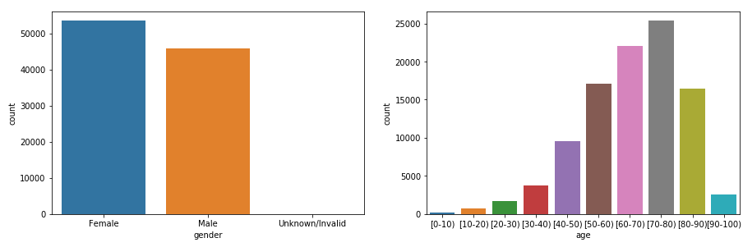
Data Understanding
Viewing the numerical and categorical variables in the dataset to understand the dataset better,

Slide 10
Data Preparation
We had different types of data: numerical, object type and categorical. To apply any model, preprocessing of data is essential.
Dealing with the missing values by dropping the columns which had too many missing values.
Modifying the data like standardization, log transform.
Dealing with the categorical variable like Readmitted to make it dummy variable suitable for applying ML techniques.
The challenge was that there were too many variables so cleaning and making sense of the data was a challenge but step by step approach helps!

Slide 11
Modeling, Evaluation and Feedback
The models chosen were:-
Logistic Regression
Random Forest
Adaboost Classification
Adaboost Classification with Tuning
Decision Trees
These models were chosen since our aim was prediction of readmission of diabetic patients.

Slide 12
Modeling, Evaluation and Feedback
The following were used to analyse the performance of the model:
Accuracy
Classification summary (recall, precision, etc.)
Confusion matrix
ROC curve

Slide 13
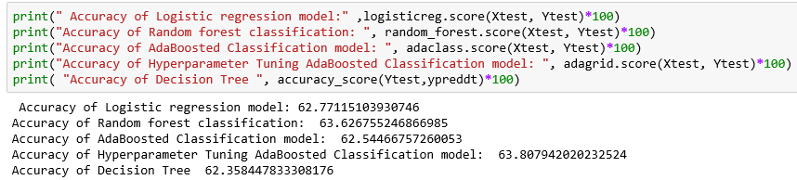
Modeling, Evaluation and Feedback
Accuracy of the models:

Slide 14
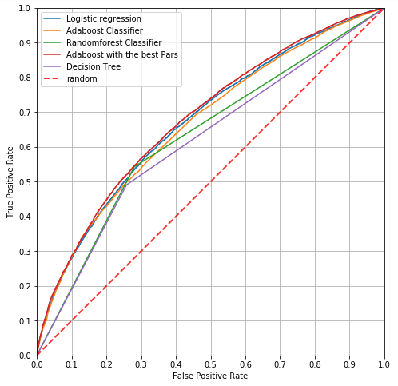
Modeling, Evaluation and Feedback
ROC curve:

Slide 15
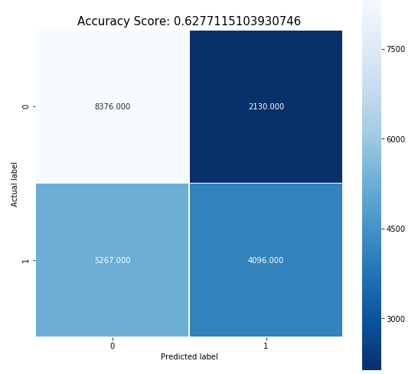
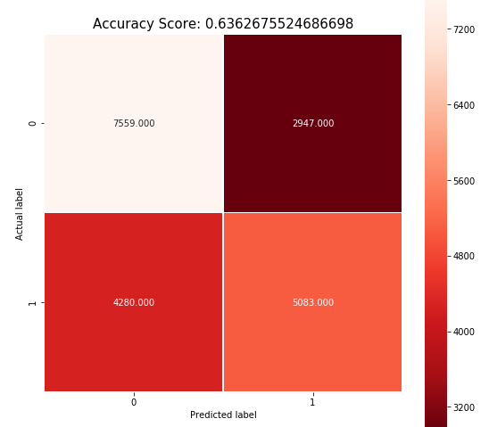
Modeling, Evaluation and Feedback
Logistic Regression
Random Forest Classification

Slide 16
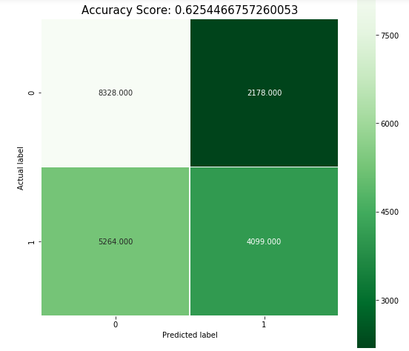
Modeling, Evaluation and Feedback
Adaboost Classification

Slide 17
Modeling, Evaluation and Feedback
Based on the above accuracy and recall values:
Random forest seems like the best model to use.
The number of False negatives in Random forest are less and the accuracy is higher than the rest of the models.
The accuracy is about 64%.
Adaboost after tuning also gives a good accuracy but, Random forest is more easily understandable.
Hence, we should go ahead with Random forest.

Slide 18
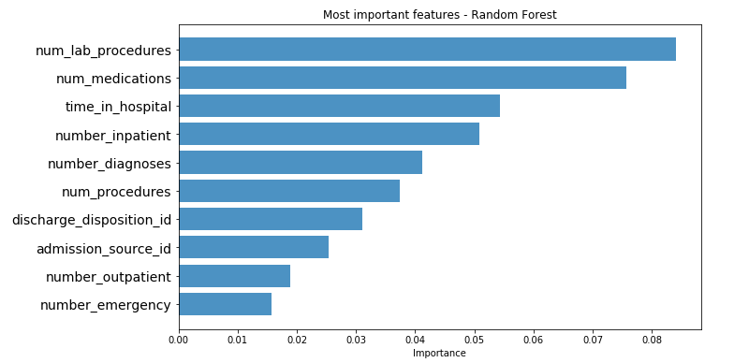
Business Recommendations
From deploying multiple models, we came up with Random forest.
Now we can suggest to the hospital authorities the variables which have the most effect on the readmission rate.
The diagram below explains it all:-

Slide 19
Assumptions, Limitations & Further Works
The dataset includes some useful information but still lack certain aspects like access to care etc. which might impact the readmission to a huge extent.
More data preprocessing could have been performed to improve the model accuracy further. So, in future this is one area which can be explored.
Variations of different machine learning techniques can be used.

